Slide 1
Physics Capstone
(PHYS 4195W)
Class #1
Introduction & Overview
Class Expectations & Syllabus
21st-Century Physics Careers
Skills of Physicists

Slide 2
What is a Capstone Experience? (Group discussion)
“a multifaceted assignment that serves as a culminating academic and intellectual experience for students, typically during their final year of high school or middle school, or at the end of an academic program”
“capstone projects may take a wide variety of forms, but most are long-term investigative projects that culminate in a final product, presentation, or performance”
“generally designed to encourage students to think critically, solve challenging problems, and develop skills such as oral communication, public speaking, research skills, media literacy, teamwork, planning, self-sufficiency, or goal setting”
Glossary of Education Reform

Slide 3
GW’s Physics Capstone Experience
Structure of Capstone & Research courses:
Fall junior year: Physics Capstone (PHYS 4195W)
Spring junior – Fall senior year: Undergraduate Research (PHYS 4196, PHYS 4197, ASTR 4195)
Spring senior year: Physics Symposium (PHYS 4200)
Physics Capstone (PHYS 4195W):
Preparation & skills for doing research
Preparation for various physics careers
Physics Symposium (PHYS 4200):
Oral & written presentations of research

Slide 4
Physics Capstone: Learning Objectives
Explain and discuss the nature of physics research processes and methods
Explain and discuss ethical conduct of research and physics community issues
Analyze, interpret and report on physics research articles and proposals
Explain career paths in physics, and demonstrate how to apply for competitive research opportunities, job employment, and admission into graduate schools
Demonstrate proficiency in communicating physics ideas and research in an audience- and disciplinarily appropriate manner

Slide 5
Physics Capstone: Deliverables
Written communication:
Summary of research articles
Abstract of research topic
Abstract for proposal
Resume & cover letter
Oral communication:
Summary of research articles
Proposed research topic
Elevator pitch
Ready to go for research
Tools for various physics careers

Slide 6
Physics Symposium: Learning Objectives
Demonstrate proficiency in written communication of physics research through a report and producing a poster
Demonstrate proficiency in oral communication of physics research through presenting a poster and an oral presentation
Demonstrate proficiency in peer review of written and oral presentations

Slide 7
Physics Symposium: Deliverables
Written communication:
Poster for GW Research Days
Report on undergraduate research
Oral communication:
Poster at GW Research Days
Presentation at Physics Symposium Day
Tools for various physics careers

Slide 8
Course Format
Lectures with active participation:
Discussions
Writing & exercises
Formal/informal presentations
Feedback through peer review
Guest lectures from specialists
Homework:
Reading materials
Writing & exercises
Preparation for presentations
Office hours

Slide 9
Preparing Physics Students for 21st-Century Careers
What skills and knowledge should the next generation of undergraduate physics degree holders possess to be well prepared for a diverse set of careers?
Notes:
Read it! We’re not going to read it for you today.

Slide 10
Which skills do physicists have/need? (Group discussion)
Physics-specific knowledge
Use fundamental concepts to solve problems
Apply basic laws of physics to applied contexts
Solve problems involving multiple topic areas
Scientific & technical skills
Use numbers and statistics to solve problems
Solve problems through experiments, simulations, and analytical models; and identify resource needs
Analyze a problem to develop creative, innovative, and workable solutions; and implement them
Competent in instrumentation, software, coding and data analytics

Slide 11
Which skills do physicists have/need? (Group discussion)
Communication skills
Oral & written communication for audiences with a wide range of backgrounds and needs
Convince or influence others
Professional & workplace skills
Ability to work in diverse teams
Obtain knowledge about relevant technology resources
Effective management of difficult situations
Awareness of physics career opportunities and effective practices for job seeking
Familiar with project management and budgeting
Planning, organizing, and prioritizing work

Slide 12
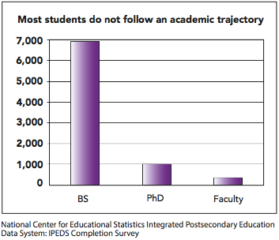
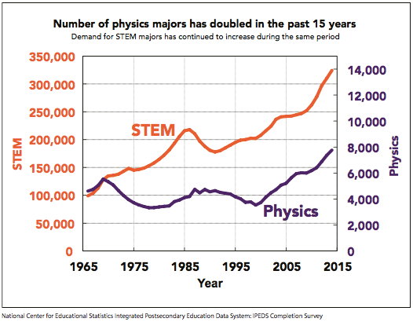
Physics Employment (1/5)
5% of physics bachelor’s graduates become physics professors
Notes:
Read it! We’re not going to read it for you today.

Slide 13
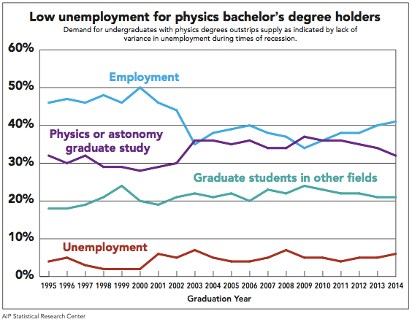
Physics Employment (2/5)
30% of physics bachelor’s graduates enroll in physics grad school
Notes:
Read it! We’re not going to read it for you today.

Slide 14
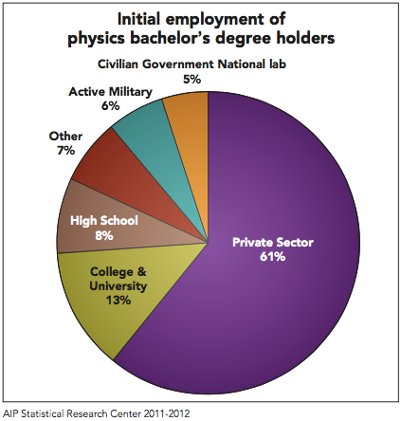
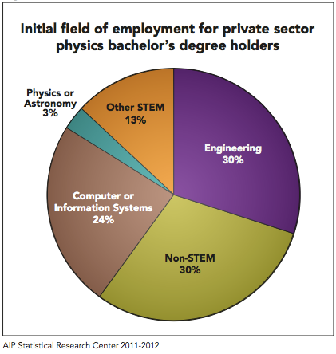
Physics Employment (3/5)
22% of physics bachelor’s graduates work in non-STEM jobs
Notes:
Read it! We’re not going to read it for you today.

Slide 15
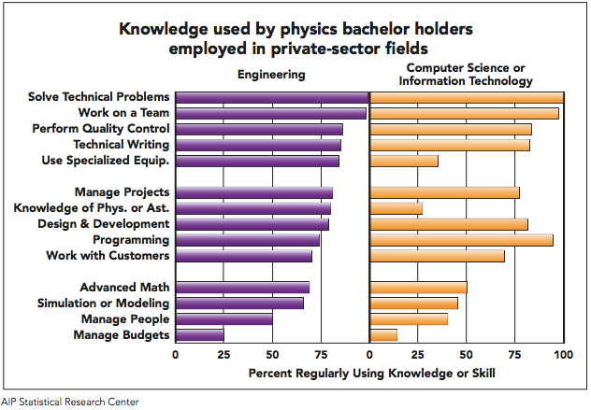
Physics Employment (4/5)
21% of physics bachelor’s graduates work in engineering; 17% work in computer or information systems
Notes:
Read it! We’re not going to read it for you today.

Slide 16
Physics Employment (5/5)
82% of physics bachelor’s graduates working in private-sector STEM positions are satisfied with their job security
84% of physics bachelor’s graduates working as high school physics teachers are satisfied with the level of responsibility
84% of physics bachelor’s graduates working in government or national labs are satisfied with their salary and benefits
93% of physics bachelor’s graduates working in active military are satisfied with their opportunity for advancement
Notes:
Read it! We’re not going to read it for you today.

Slide 17
Physics Careers
There is no standard physics career path
Physicists have a multitude and variety of skills that employers are very interested in
Which skills do you have?
Which skills do you currently have?
For the current skills, what evidence do you have?
Which skills do you expect to have at graduation?
(Individual activity)

